Slide 1


LECTURE
Game Publishing
Game Production
Diploma in IT
Notes:
Hello everyone, today we will be talking about game publishing. So, you have a game idea and you want to get it made. How do you go about doing that? What does it take to get a game from idea to implementation to distribution? In this lesson, we provide an overview of how a game gets to the stage where you can download it from an app store or game distribution platform like Steam.
In this lesson we will talk about two types of companies: game publishers and game studios. Game studios make the game, and game publishers publish them. What does publish mean? Stay tuned to find out!

Slide 2
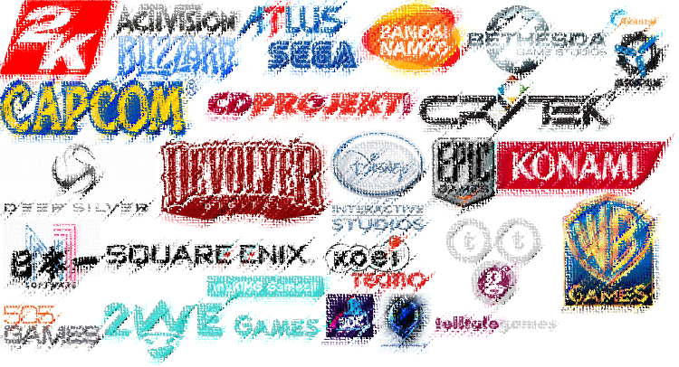
Game Publishers
Notes:
First, we will talk about Game Publishers. You know the first fancy splash screen that you see when you load up a game? That’s probably the publisher’s logo. Famous publishers include, Sony, Nintendo, Apple, Microsoft, Blizzard and EA.

Slide 3
Game Publisher
Company that publishes the games
Games may be developed by internal staff or studios
Publishers may commission external studios or developers to build a game
Games may be developed by external game studios or developers
Approach publishers to publish
or
Publishers “buy” over the rights to publish
Notes:
Essentially, a Game Publisher is a company that publishes games. The games that they publish may be developed internally by the company itself, or publishers may commission external studios to develop the game.
The collaboration between the studio and the publisher may be initiated by either party, meaning that the studio may pitch the game to the publisher to get them to publish the game, or the publisher might approach the studio to offer to publish their game, which might involve buying over some or all of the rights to the game.
But what does publishing actually mean?

Slide 4

Responsibilities
Finances the game
Answerable to shareholders
Charts game development direction
Involved in risk management
Helps to distribute resources
Pays for licenses involved in development
Often involved in quality assurance testing
Markets to players
Sells to players
Manufactures game media
Notes:
The term “game publishing” encompasses a broad range of responsibilities. The main function of the publisher is to finance the game, which puts them in the role of product owner. And if it is a publicly listed company, then the publisher is answerable to its shareholders.
As a result, the publisher will set deadlines and checkpoints based on their risk assessment. Since they control the funding, they will help to determine how that funding will be spent. They also pay for any licenses involved in the development, from software to art and sound assets to intellectual property.
Game publishers will often be involved in QA testing, as they may have a sense of their target audience and be able to suggest improvements to the game. They are also in charge of marketing to players, like holding press events and online advertising, and also sometimes selling directly to players. In the old days, they also manufacture game media, such as burning the software onto DVDs and printing out the manuals, but these days the majority of games are delivered online. Still, very popular games may spawn other media like action figures or Funko Pop figurines, and publishers will be involved in that process.

Slide 5
Financing Options
Publisher’s decision to fund (full or partial)
Reputation of developer or game studio
Current state of game / prototype
Potential return on investment
Retain partial or full control of IP rights
Game studios may seek other forms of funding
self-funding, crowd-sourcing, venture capital, bootstrapping
Notes:
Speaking of controlling the funding, the amount of funding could be full or partial. Whether the publisher pays for part or all of the development costs depends on a few factors.
One is the reputation of the developer or game studio. If the developer or studio has had a lot of previous success, it shows that they know what they are doing and their new game will be more likely to succeed. This is especially important when it comes to sequels to successful games.
Another factor is the current state of the game or the prototype. If the publisher sees that the game is mostly finished, or they can see that the game has that something special that they believe will make it a hit, they are more likely to invest more to the project
Ultimately, it is all about return on investment.
An important aspect to consider is Intellectual Property, or IP, rights. Many games build worlds or create characters that are considered creative products with value possibly beyond the actual game. IP’s like Harry Potter, Animal Crossing or Angry Birds can be very valuable as they come with an existing fanbase that will be more interested in additional products in that line, whether it’s a sequel game, a movie or T-shirts. Publishers can allow the studio to retain full or partial IP rights, or even buy over the IP entirely.
That being said, some game studios may prefer not to collaborate with a publisher, with all the pros and cons of that decision. All the previous responsibilities such as project management, testing and marketing still has to be fulfilled, but the studio will take up that responsibility themselves. If they choose not to join up with a publisher, they may fund the project themselves, use crowd-sourcing like Kickstarter, or maybe look for private investors who may not be full-time publishers. This may even be asking friends and family members to loan them some money during the development process.
In the long run, game studios that want independence in their decisions usually do something called bootstrapping. Basically, they take the profits of their first game and feed it into the development costs of their next game. Eventually, when (and if) they manage to produce a lineup of good games, they will become financially solvent enough to expand their company and be profitable.

Slide 6
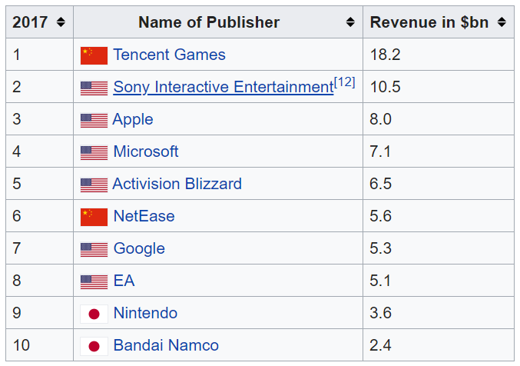
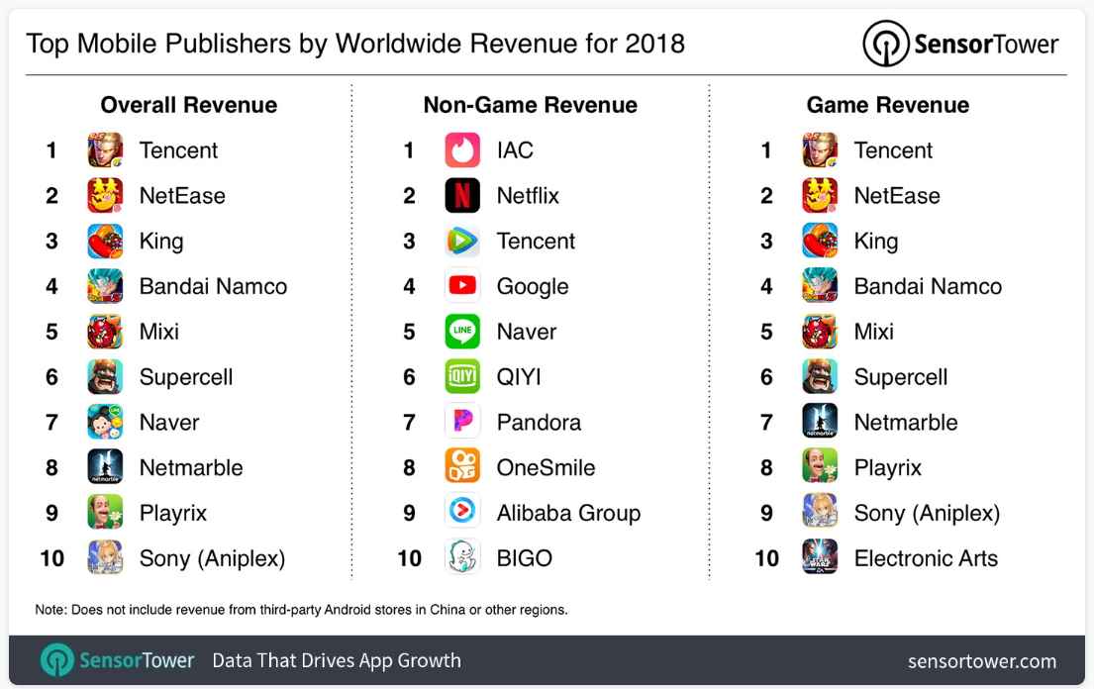
Leading Game Publishers
Notes:
To the left is the list of top publishers in 2017 by revenue. On top of that list is Tencent (or teng2 xun4 in Chinese), who owns QQ as well as several online games such as League of Legends and partially owns PUBG. Yes, that 18.2 is in BILLIONS of US dollars. I’m sure you recognize most of the other names on that list, like Sony, Apple, Microsoft and Blizzard.
To the right are the top mobile publishers. Other than Tencent, the other names are slightly different. You see NetEase (or wang3 yi4) in second place who owns Westward Journey and has partnerships with Blizzard for local versions of many of their games. There’s also King with Candy Crush, Mixi with Monster Strike and Supercell with Clash of Clans.
It’s a big business, which shows no signs of slowing.

Slide 7
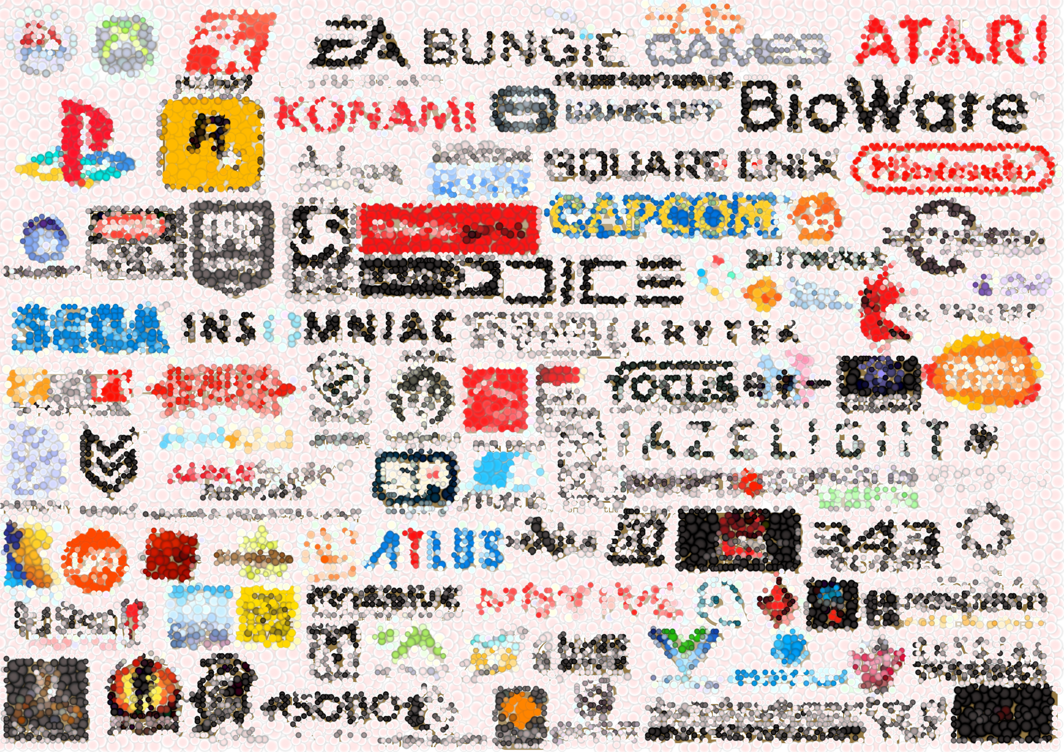
Game Studios
Notes:
OK, so that’s game publishers, who publish games. But the companies that actually develop the games are called game studios, and there are lots of them. When people say that they are working in a game company, they usually mean that they are working in a game studio.

Slide 8
Game Studios
They develop games!
May be privately owned or owned by publishers
Normally have stable source of financing
Normally have a specialisation on genres
Can consist of 1 team or multiple teams
May consist of sub-teams
Can be made up of fulltime staff, parttime staff and interns
Work can be outsourced
Notes:
Simply put, game studios are companies that develop games. Most of the better known game studios are owned by publishers. For example, Rockstar, who develops GTA and Red Dead, are owned by Take-Two Interactive, and BioWare, who did Mass Effect and Dragon Age, is owned by EA. But there are still some prominent studios who are still privately owned, independent companies, such as Valve, who did Counter-strike, DOTA2 and Half-Life (hmm, I just named 3 games, Half-Life 3 confirmed).
Game studios usually specialize in specific genres and have an identifiable style, to the point where you just have to name the company that made the game to have an idea of the type of game you are referring to. A Rockstar game is likely to be a huge, sandbox-style game, while a Square Enix game will probably have Japanese manga sensibilities, and you know that any game made by Zynga will be casual, so-called “freemium” games with lots of microtransactions. This is because when game studios form a team to develop a game, the members of the team will have certain skills and capabilities. Therefore, it just makes sense to make more games of a similar genre in order to leverage on the skills of their existing employees.
As game studios grow and they expand their repertoire, they may form more teams. It is not uncommon for a studio to have multiple teams that specialize in particular genres of games or different platforms. The teams can be full-time employees, contract staff or interns. And most small companies will outsource at least some of their work as they may not be able to afford to hire full-time staff to fill certain positions, such as sound engineers or language translators.

Slide 9
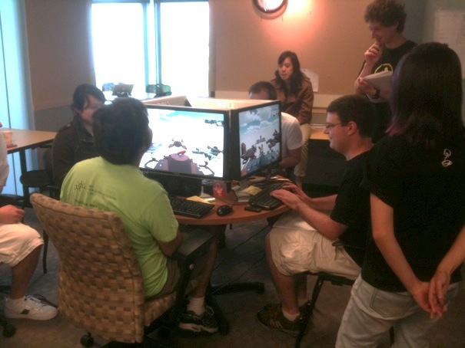
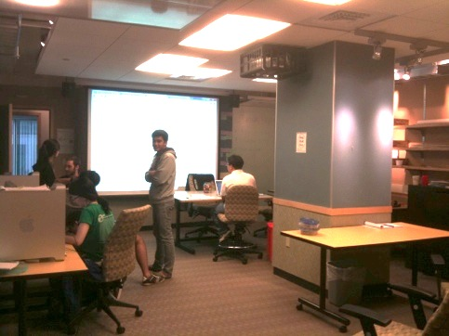
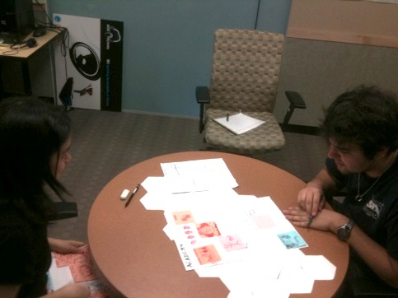
Quality of Life
Casual working environment
No dress code or formal office conduct
Free food, beverages and snacks
No official working hours
No formal office environment
possibly virtual offices and meetings
No daily deliverables, only end-goals/end-dates
Leads to crunches
Notes:
You may have heard stories of some game companies starting off as just a couple of college students working on the game in their spare time. Interestingly, this origin of game companies has affected the working environment of game companies. It is almost a cliché now that game companies have a more casual working environment than most software companies.
There is usually no dress code or formal office conduct. There is frequently no official working hours, and in fact sometimes there isn’t even an office. There are some companies whose development teams consist of people from all over the world working remotely.
When there is an office, it is often stocked with free food, beverages and snacks. Employees will schedule meetings as needed and be able to stay at the office for an extended time if necessary. This is because the key to game development is hitting milestones and checkpoints rather than doing daily work.
While this does have the advantage of being very flexible to change, it will lead to a pile-up of work if the time is not managed properly. This is especially serious as the shipping deadline approaches, which is known as “crunch time”. You hear horror stories of people working 80-hours weeks for months due to bad planning or unforeseen circumstances.
Is this a good or bad working environment? That’s for you to decide.

Slide 10
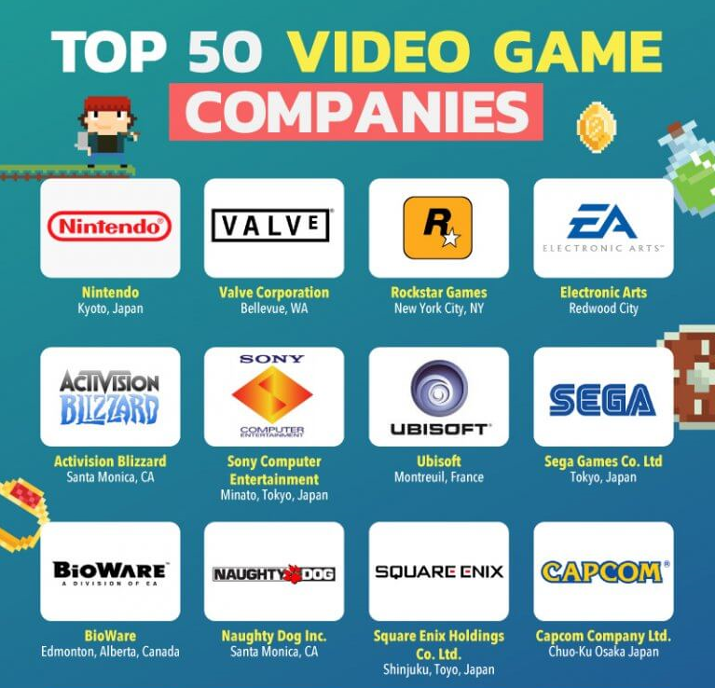
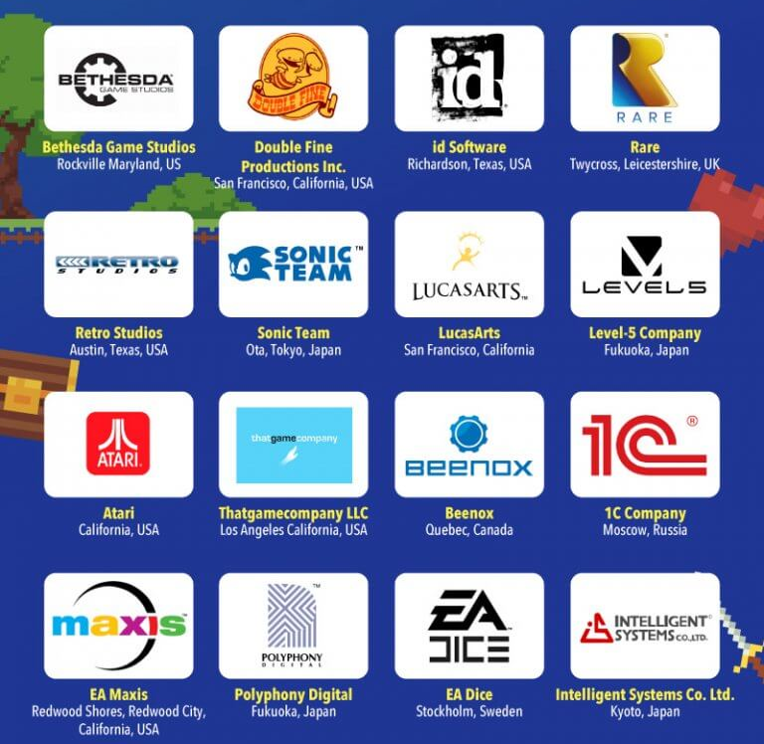
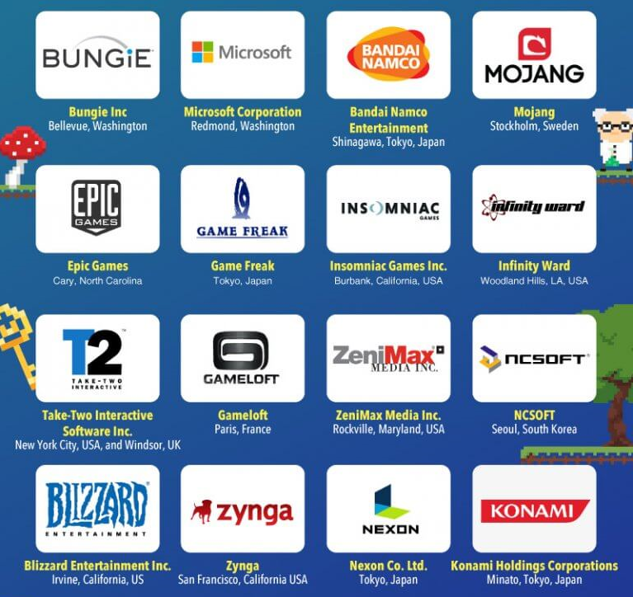
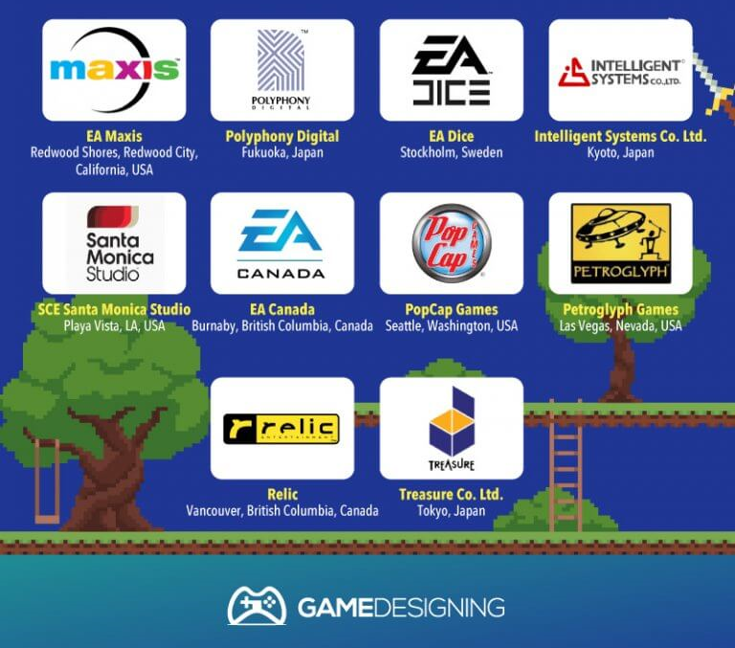
Top 50 Studios of 2018
Notes:
https://www.gamedesigning.org/game-development-studios/
Here is a list of the top 50 video game studios in an article by gamedesigning.org. There are a lot of famous names here, and if you haven’t heard of the company it’s quite likely that you have heard of the games that they make. These companies are based all over the world, including the United States, Europe, China and Japan, and most have subsidiary offices in multiple countries.

Slide 11
Indies (Independent Games)
Created by individuals or a small team
Often work in virtual teams
Personal venture or interest to join team
Often a spin-off from college or university days
No financial support from any publishers
Funding is a key problem
Sourced from private investors
Often seconded to do work by game publishers or studios
May be eventually bought up
Example: Minecraft (www.minecraft.net)
Notes:
Those were the big boys, the multi-national, multi-million dollar companies that make huge games. However, there is another path into game development, which is to produce independent games, or Indies.
These are the games made by a single person or a small team, often by people who met in school and have a shared passion for game development. Like, for example, people who take the Game Production module.
The main problem with this model is that you still have to eat. While you are developing your game, you either have to have another source of income or get some private investor, like friends, relatives or winning the lottery, to meet you daily expenses. This is why indie games are often done during the developer’s spare time. However, if the game is completed and starts to make money, you can gradually use your profits to fund your next game, and so on.
Good indie game studios will eventually get noticed, and game publishers may approach them to develop games based on the indie company’s IP’s, which is another source of funding. Finally, game publishers may buy out the company completely, sometimes for large sums.
One of the biggest indie success stories is Minecraft, which was developed by a Swedish programmer Markus Persson under his company Mojang that was bought by Microsoft in 2014 for US$2.5 billion. Other notable successes include Flappy Bird by solo Vietnamese programmer Nguyen Ha Dong, Angry Birds by Rovio Mobile, and Undertale by one person - Toby Fox.

Slide 12
Indies’ Motivation
Focus on innovation and creativity
Spirit of entrepreneurship
Community spirit of sharing and aiding
Building the games the developers want
Profit is not always the main driver
Professional game development tools are affordable
Unity, GameMaker
Aided by online distribution model (e.g. Steam)
Big successes are rare
Notes:
On the other hand, the fact that Indies do not have the resources of large game companies does present some definite issues. Notice that most of the successful indie games focus on innovation and creativity, because it is almost impossible to develop a cookie-cutter version of an existing game genre because the larger companies will outdo the indie in terms of quality. Instead, the successful indie game has to have some innovative gameplay that larger companies may not be inclined to try because of the risk involved in releasing something new.
Quite often, indie developers are driven by their passion to develop the game that they themselves want to play, and not necessarily by profit. Complex and involved games on niche topics are likely to be indie because their potential market is small.
Here’s the thing: the barrier to entry to game development today is very low. It is completely feasible for one person or a small team to develop a game as a hobby and have it published. Many game engines are very cheap or free. For example, Unity3D Personal is completely free until you earn US$100K per fiscal year off your game, and Gamemaker Studio 2 is US$100 for a permanent licence. These are game engines that have made multiple successful commercial games. In fact, your Assignment 2 for GPN requires you to make a game with such a game engine, so you get to experience what it’s like to be an indie game developer.
Things are also a little easier for indie developers as online distribution platforms like Steam and App Store are available, so there is no need to actually manufacture DVDs.
That being said, indie successes are the exception, and not the rule. For every Angry Birds there are a hundred Grumpy Cat games that are completely forgotten. If you’re in it for the money, look elsewhere. But if there is a game you really want to make, then make it and join the indie community.

Slide 13
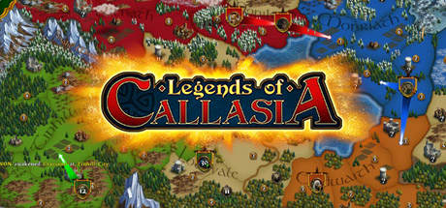
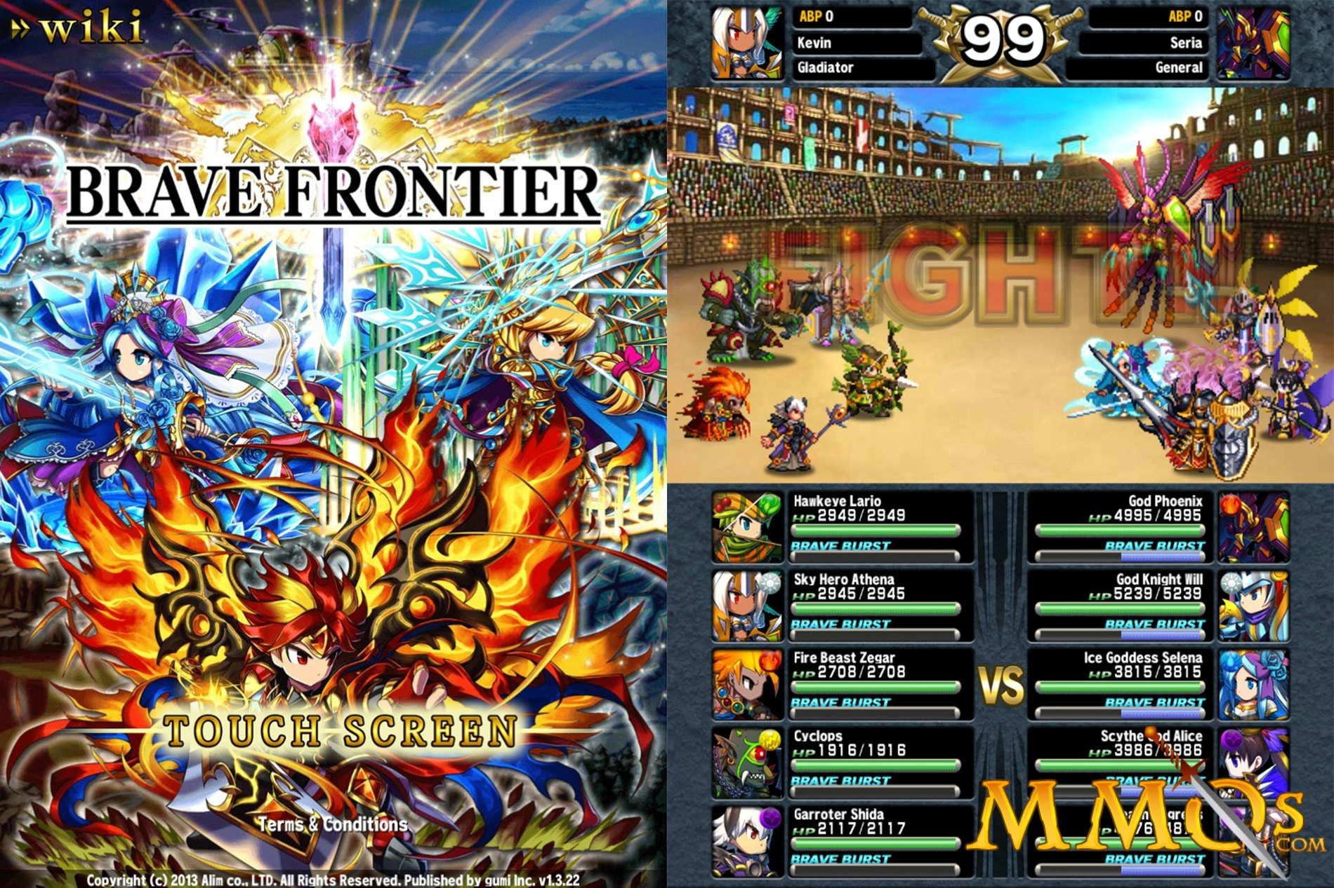
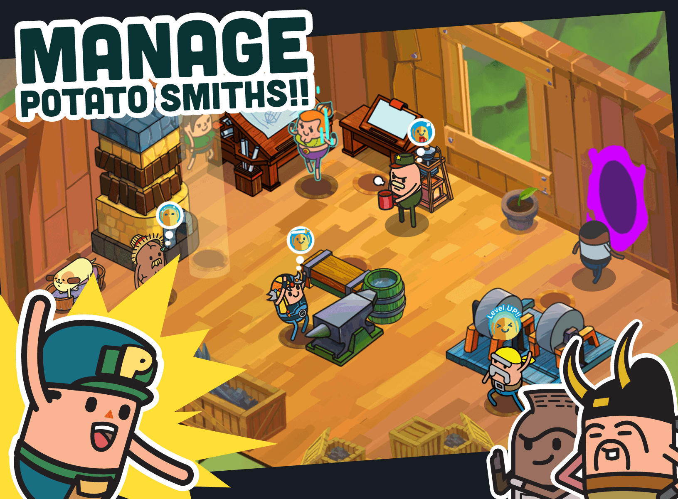
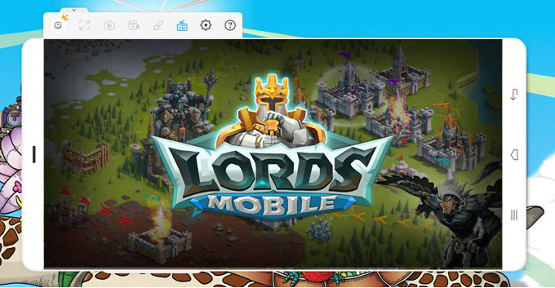
Singapore-based Companies
Mostly casual games
Boomzap Entertainment
Legends of Callasia
Daylight Studios
Holy Potatoes! series
Gumi
Brave Frontier
I Got Games (IGG)
Lords Mobile
Notes:
In fact, there are many Singapore-based game companies that started out as small indie companies, and some have grown to become reasonably successful. Most of the games are casual games, and here are a few examples.
Boomzap Entertainment was founded by Allan Simonsen and Christopher Natsuume, and they make mainly casual mobile games with a bit of depth like Legends of Callasia or the Awakening series. Their office is almost entirely virtual, with their programmers, designers and artists working from home across Asia.
Daylight Studios was founded by ICT alumnus Alwyn Lee in 2011. They are known for their Holy Potatoes! Series of casual games.
Gumi SG is a subsidiary of gumi inc. specializing in mobile games, like Brave Frontier and Final Fantasy Brave Exvius.
And I Got Games, or IGG, is a free gaming platform provider specializing in free-to-play mobile games with in-app purchases, such as Lords Mobile and Castle Clash.
And yes, there are opportunities for you to get internship positions at these companies. In particular, Alwyn at Daylight Studios has taken on multiple ICT students as interns in the past.

Slide 14

Checkpoint
Would you want to work in a major game studio?
If so, which one, and why?
Would you want to work in an indie game studio?
Would you want to become an indie developer?
AAA Studio
Indie
Notes:
At this point, you should have a decent idea about game studios. So let’s take a moment to answer the following questions.
Number one, would you want to work in a major game studio, like Ubisoft, Blizzard or Nintendo? This would mean that you will probably be part of a decent-sized team working on major games, but your individual influence on the game will then be diluted. Is there a major studio that you really want to work for, and if so, which one and why?
Or are you someone who prefers to work in a smaller indie game studio, where you are working in a lean team of probably fewer than 10 people? So while your inputs will have a much more significant effect on the games you make, you will have to fill more different roles, and your game will probably have a smaller market share.
Or are you someone who doesn’t want to work FOR anyone? Instead, you’re happy to either start your own indie game company or develop your games all by yourself? If so, what’s your strategy, and how will you pay your bills before your efforts pay off?
Think about this, and write your answers down in the bio section of your e-Portfolio. If nothing else, it will be interesting to read in 10 years after you make your first billion dollars from your games.

Slide 15

Summary
You should have a better understanding of:
Game publishers
Game studios
Indie game development
Notes:
Right. You should now have an idea of what it is that game publishers do, and the difference between a game publisher and a game studio, even though many companies fill both roles. You should also have an idea of the indie game movement, and in Assignment 2 of Game Production you will get a chance to develop your own digital game prototype, just like an independent game developer.
Exciting, no?

